Slide 1
https://youtu.be/HsUp0V_HqEY
Why we need to know computer and computing?
https://youtu.be/-D5N_OnZ_Tg

Slide 2
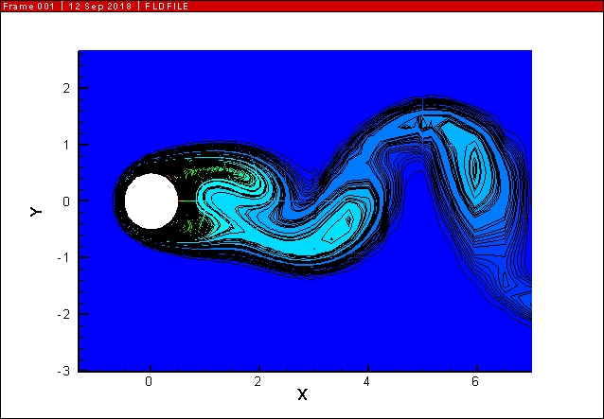
Some CFD cases in my Lab.

Slide 3
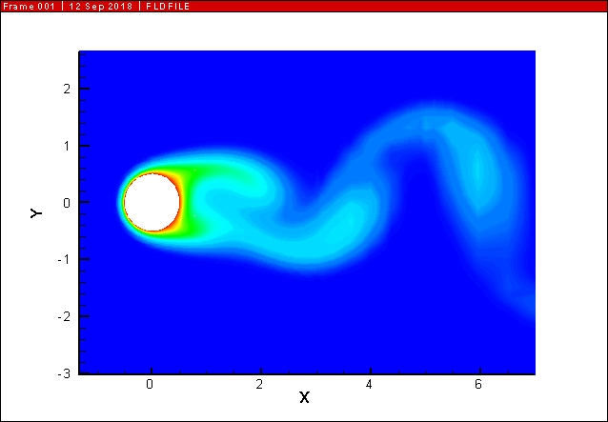

Slide 4
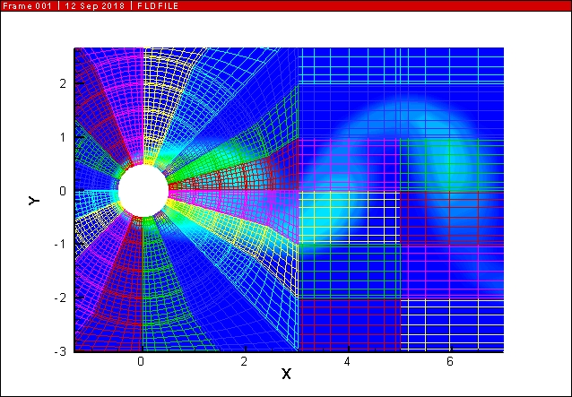

Slide 5
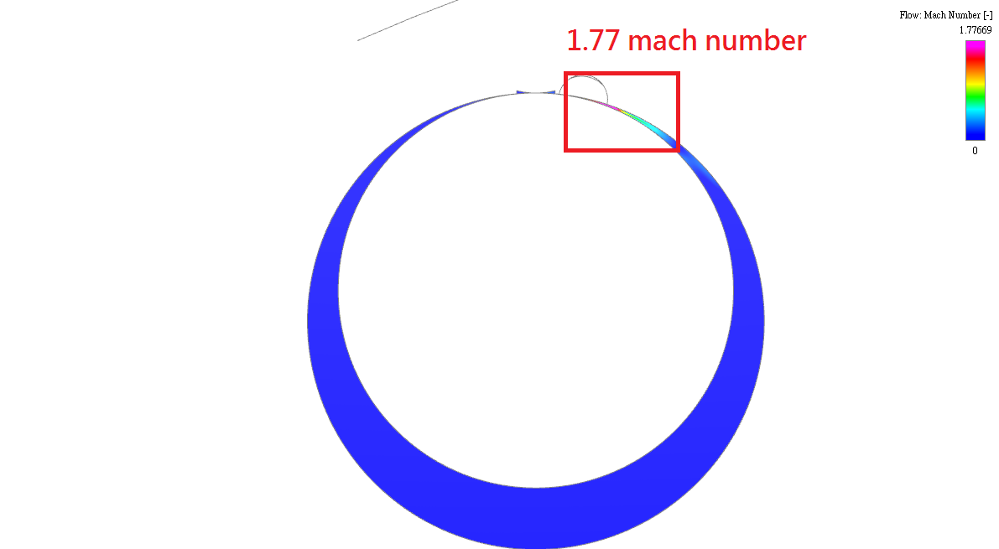
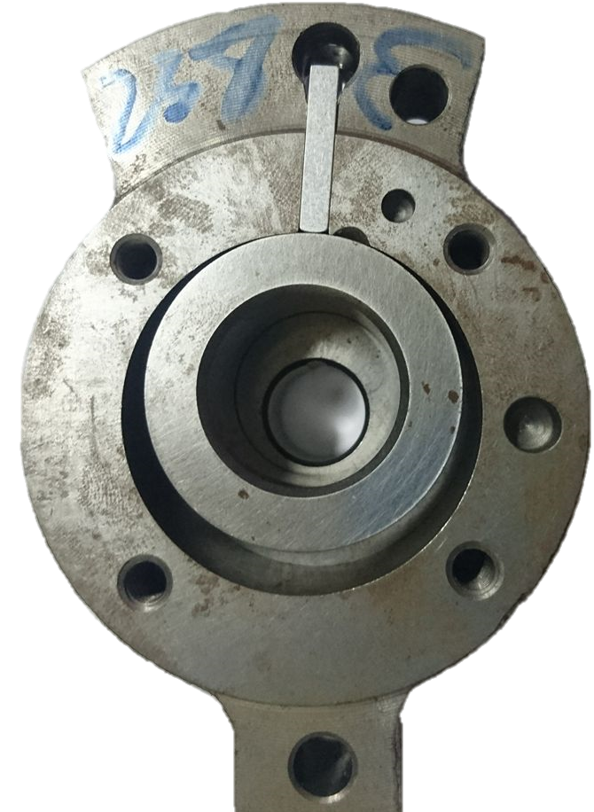
2210-45馬赫產生間隙對照

Slide 6
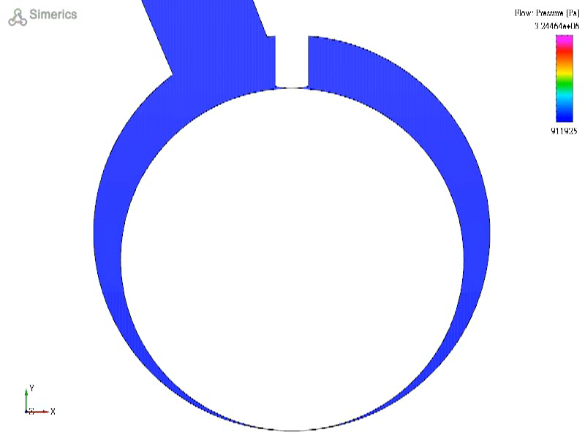
活塞動畫-壓力
活塞切面位置

Slide 7
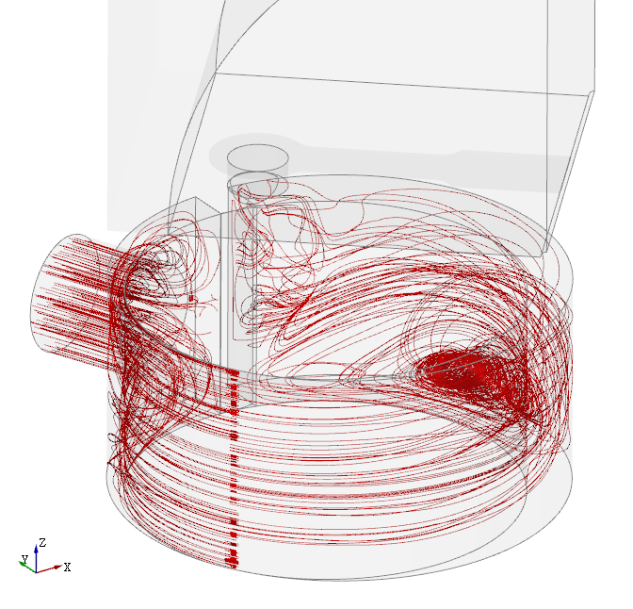
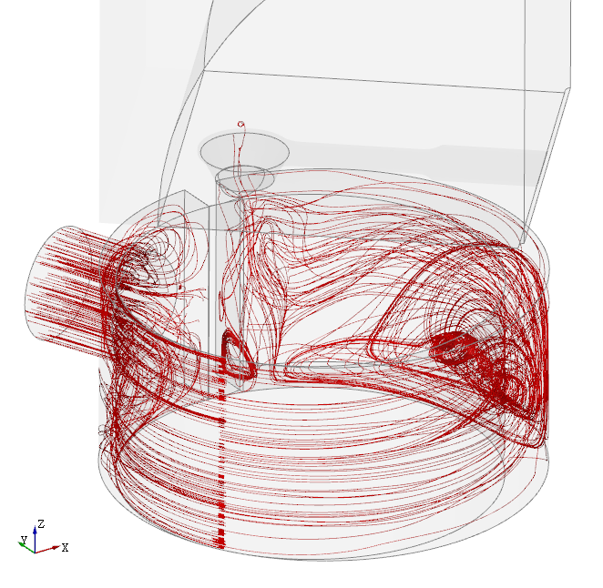
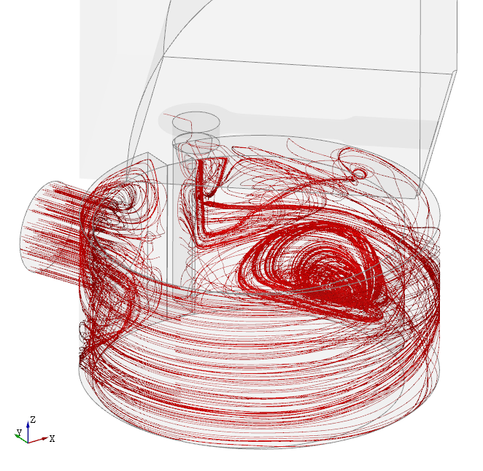
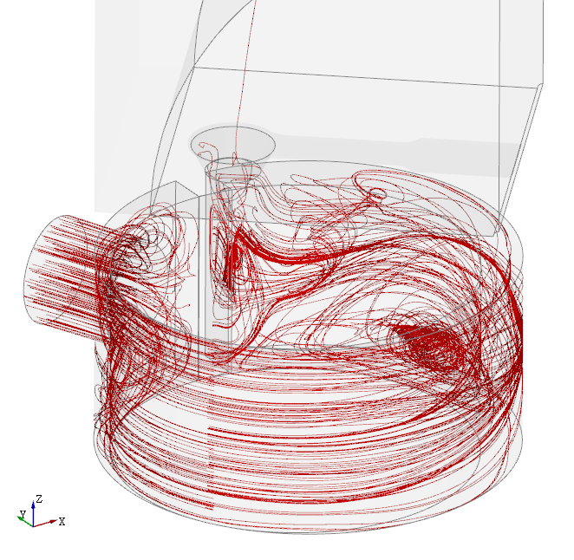
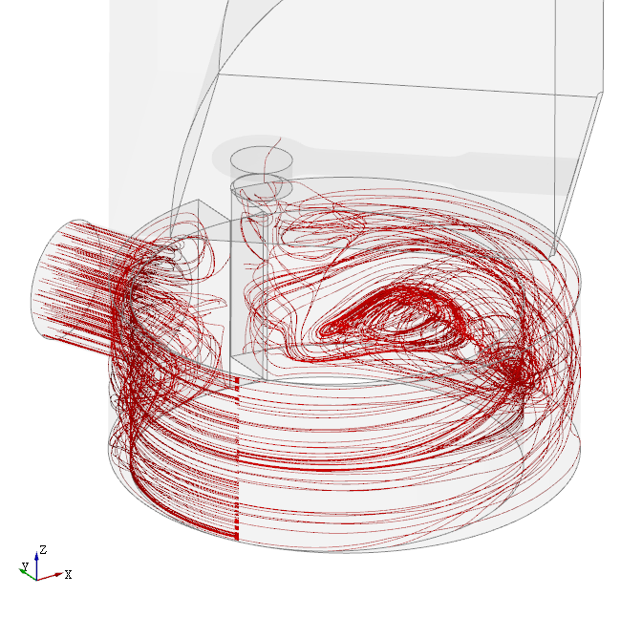
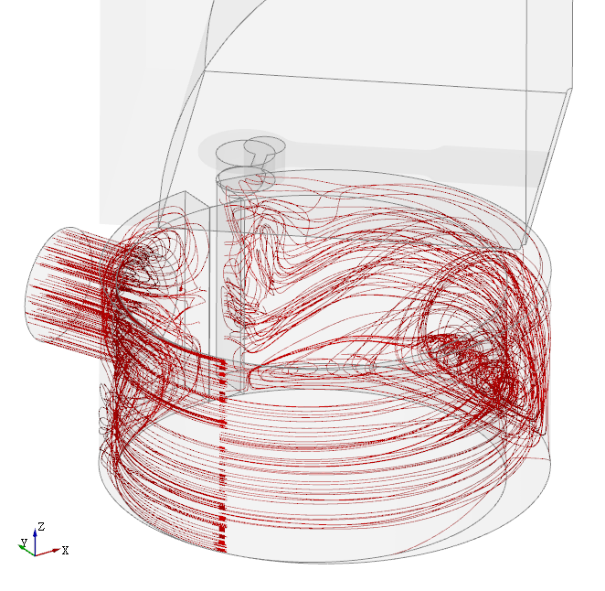
活塞 120 度
2210-45
2210-45-Nozzle
2210-60
2210-60-Nozzle
2210-45-Height15
2210-45-Resonance

Slide 8
More Applications
Computational Fluid Dynamincs (CFD)
Control
Unmanned aerial vehicle (UAV)
AI

Slide 9
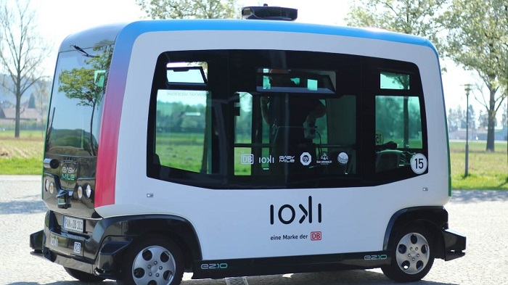
First Self-Driving Bus Service ioki Operating in Germany

Slide 10
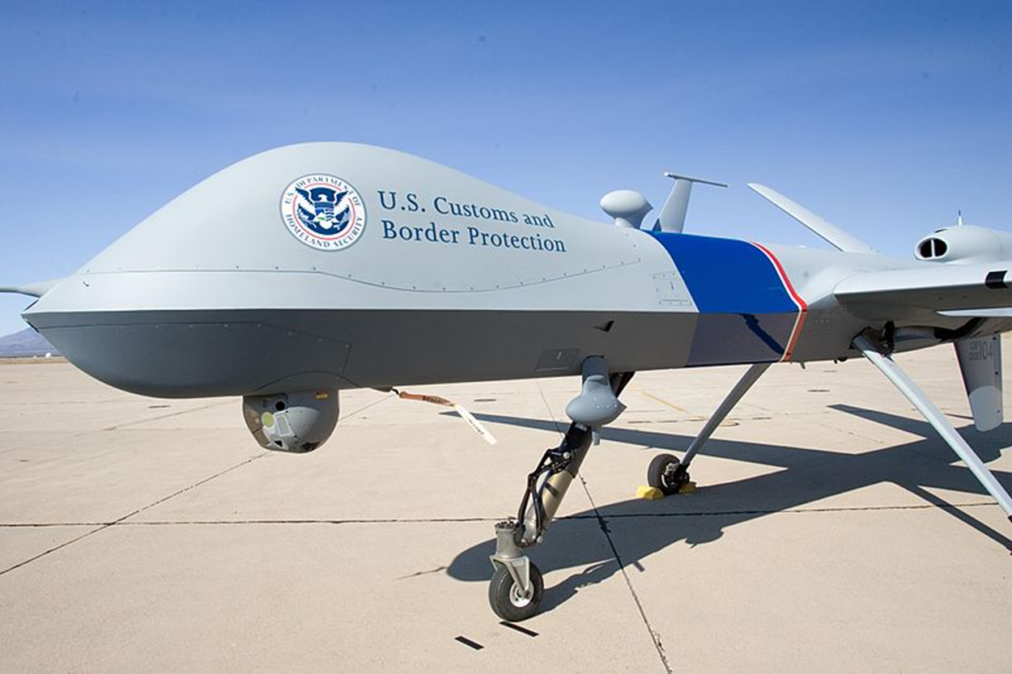
Unmanned aerial vehicle (UAV)

Slide 11
Chapter 1
Introduction to Computers and
C++ Programming

Slide 12
Overview
1.1 Computer Systems
1.2 Programming and Problem Solving
1.3 Introduction to C++
1.4 Testing and Debugging

Slide 13
1.1
Computer Systems

Slide 14
Computer Systems
A computer program is…
A set of instructions for a computer to follow (program)
Computer software is …
The collection of programs used by a computer
Includes:
Editors (show devcpp)
Translators
System Managers

Slide 15
A sample of Program
#include<iostream>
#include<cmath>
using namespace std;
int main()
{
int i,j,k;
for(i=1; i<=9; i++)
{
for(j=1; j<=9; j++)
{
k=i*j;
cout<<i<<" "<<j<<" "<<k<<endl;
}
}
return 0;
}

Slide 16
Hardware
Three main classes of computers
PCs (Personal Computer)
Relatively small used by one person at a time
Workstation
Larger and more powerful than a PC
Mainframe
Still larger
Requires support staff
Shared by multiple users

Slide 17
Networks
A number of computers connected to share resources
Share printers and other devices
Share information

Slide 18
Computer Organization
Five main components
Input devices
Allows communication to the computer
Output devices
Allows communication to the user
Processor (CPU)
Main memory
Memory locations containing the running program
Secondary memory
Permanent record of data often on a disk
Display 1.1

Slide 19
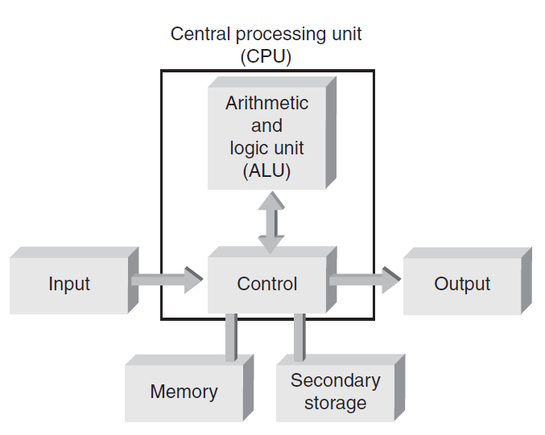
Computer Hardware
Computer hardware: Components that support the capabilities of the computer
Figure 1.15 Basic hardware units of a computer
© 2013 Cengage Learning. All Rights Reserved. This edition is intended for use outside of the U.S. only, with content that may be different from the U.S. Edition. May not be scanned, copied, duplicated, or posted to a publicly accessible website, in whole or in part.

Slide 20
Computer Memory
Main Memory
Long list of memory locations
Each contains zeros and ones
Can change during program execution
Binary Digit or Bit
A digit that can only be zero or one
Byte
Each memory location has eight bits
Address
Number that identifies a memory location

Slide 21
電腦的演進
自從真空管電腦出現後，電腦的組織元件不斷推陳出新，歷經真空管、電晶體、積體電路、超大型機體電路等四個階段，分別被稱之為第一代、第二代、第三代、第四代電腦。其特色如下表格：
 | 第一代 | 第二代 | 第三代 | 第四代
元件 | 真 空 管 | 電 晶 體 | 積體電路 | 超大型積體電路
時期 | 1942~1958 | 1959~1963 | 1964~1970 | 1971年~現今
內部作業速度 | 10⁻³ 秒 | 10⁻⁶秒 | 10⁻⁹ 秒 | 10⁻⁹~⁻¹³ 秒
輸入裝置 | 打孔卡紙 紙條裝置 | 打孔卡紙 | 按鍵 磁碟 | 鍵盤輸入 指標裝置 光學掃描
輸出裝置 | 打孔卡紙 列印輸出 | 打孔卡紙 列印輸出 | 列印輸出 螢幕影像 | 螢幕影像 語音輸出 列印輸出
主記憶體材質 | 磁鼓 | 磁蕊 | 磁蕊 | 半導體晶片
輔助記憶體材質 | 磁鼓 磁帶 | 磁帶 磁碟 | 磁碟 磁帶 | 磁碟 光碟 磁帶

Slide 22
電腦的演進歷史
22
第一代電腦（真空管：1942~1958年）：
從第一部商業用途電腦UNIVAC開始，真空管(vacuum tube)就被充當電腦的核心元件，真空管如同燈泡一樣，一部電腦必須使用多達千個以上的真空管組成，因此體積非常龐大。並且真空管的耗電量驚人且容易產生高熱，當真空管被燒毀時，必須更換真空管，因此第一代電腦需要大量的散熱設備。
第二代電腦（電晶體：1959~1963年 ）：
電晶體(Transitor)在1948年被發明，從此開始，科學家就努力的想要使用耗電量較小的電晶體來製作電腦，如此一來，將可以減少電力消耗且不需要大量散熱設備。不過，由於當時生產同一性質的電晶體非常困難，因此當某一個電晶體被燒毀後，就很難找到相同特性的電晶體來加以更換。
直到1954年，面障電晶體(Surface barrier transistor)問世後，才突破此項困難。麻省理工學院(MIT)研發的TX-0是第一部電晶體電腦，在此時期，尚有IBM的7090、Burroughts的B-200系列等，這些電腦可以在百萬分之一秒內，完成數十個加法運算。使用電晶體製作的電腦，在運算速度方面，比真空管電腦快了許多，而且體積小、耗電量少、不需巨大的冷卻系統、不需要暖機、壽命長、準確性高，因此淘汰了真空管電腦。

Slide 23
電腦的演進歷史
23
第三代電腦（積體電路：1964~1970年）：
第二代的固態電晶體電路後來被單晶積體電路(Monolithic Integrated Circuitry)及混合式積體電路(Hybrid Integrated Circuitry)所取代，積體電路(Integrated Circuitry；簡稱IC)內包含了許多的電晶體、電阻、二極體等元件，並將之微聚濃縮在一個晶片(chip)上，每個積體電路約比指甲還要小，使得電腦的體積得以大幅度縮小、成本更低、並提高了可靠度。1964年出廠的IBM 360系列就是積體電路電腦，它強調在更換新電腦時，所有舊有軟體都可以在新電腦中執行無誤，而不需要重新設計。

Slide 24
電腦的演進歷史
第四代電腦（超大型積體電路：1971年~現今）：
自從IC被發明出來以後，IC的集積度不斷提升。從包含10顆電晶體的小型積體電路（SSI），直到1971年開始製造包含10⁶顆的超大型積體電路(VLSI)。VLSI由於包含多達10⁶顆以上的電晶體，因此只要使用相當小的體積，就可以設計功能極度複雜的電路，例如微處理器(microprocessor)。VLSI的體積小、資料傳輸速度很快、準確性很高、記憶體容量也非常大，因此除了桌上電腦的中央處理器、主記憶體之外，在其他電子通訊方面的應用也越來越多，例如手機能夠做到如此小，功能如此多，都有賴半導體的發展貢獻，就目前而言，VLSI不但已經非常純熟，半導體製造廠商甚至已經具備ULSI及GSI的製造技術，使得一顆IC內可以包含10⁸~10⁹顆以上的電晶體。
【IC技術的演進】
SSI(Small-Scale Integration)： 一顆IC含10個電晶體
MSI(Medium-Scale Integration)： 一顆IC含10²個電晶體
LSI(Large-Scale Integration)： 一顆IC含10⁴個電晶體
VLSI(Very Large-Scale Integration)： 一顆IC含10⁶個電晶體
ULSI(Ultra Large-Scale Integration)：一顆IC含10⁸個電晶體
GSI(Giga-Scale Integration)： 一顆IC含10⁹個電晶體
24

Slide 25
第五代電腦
下一代(Next Generation)的電腦，究竟會出現什麼重大的變化？
這實在很難說。但歷史上曾經出現第五代電腦的說法
日本在1980年曾經提出發展第五代電腦的十年計劃，目標是要設計一個高度人工智慧的電腦，使電腦不但具有智慧、專家性質，並且能與人類透過自然語言溝通及解決問題。雖然計劃最終宣告失敗，但在此十年當中，人工智慧(AI)研究得以蓬勃發展，並且在前幾年日本成功推出風靡一時的智慧寵物（如機器狗）。
下一代的電腦究竟會出現什麼變化尚且不知，除了人工智慧之外，電腦目前正朝向更快的電腦、更小的電腦、容量更大的電腦、更安全的電腦等方向努力，並且未來的電腦系統將必具備網路及無線網路設備、並擁有更大的頻寬以及更方便、舒適的使用環境。同時未來的電腦系統將更具整合性以扮演數位家庭的控制中樞角色
【奈米科技】：
由於在奈米（10-9 m）的世界裡，許多物質的物理特性將會呈現另一種風貌，奈米科技並不僅止應用在電腦製造方面，它還可以進行許多其他方面的應用（例如製作易於清洗的清潔用品），這也就是為何市面上各類產品都可能標榜奈米技術的原因。

Slide 26
1.5 電腦的組成
電腦系統可以分為使用者(user)、硬體(hardware)與軟體(software)等三項
『使用者』就是使用或管理電腦的人
『硬體』就是組成電腦的電子元件以及各項設備
『軟體』則是一種抽象化的名詞，它必須以某種排列方式附著於某個硬體之上，例如：附著於記憶體、硬碟、光碟片中，而『軟體』的功能則是告知電腦該去做什麼或提供電腦所需要資料的來源。

Slide 27
Larger Data Items
Some data is too large for a single byte
Most integers and real numbers are too large
Address refers to the first byte
Next few consecutive bytes can store the additional bits for larger data
Display 1.2

Slide 28
Data or Code?
‘A’ may look like 01000001
65 may look like 01000001
An instruction may look like 01000001
How does the computer know the meaning of 01000001?
Interpretation depends on the current instruction
Programmers rarely need to be concerned with this problem.
Reason as if memory locations contain letters and numbers rather than zeroes and ones

Slide 29
How computer express number ?
https://www.youtube.com/watch?v=VBDoT8o4q00

Slide 30
DECIMAL
AND
BINARY

Slide 31
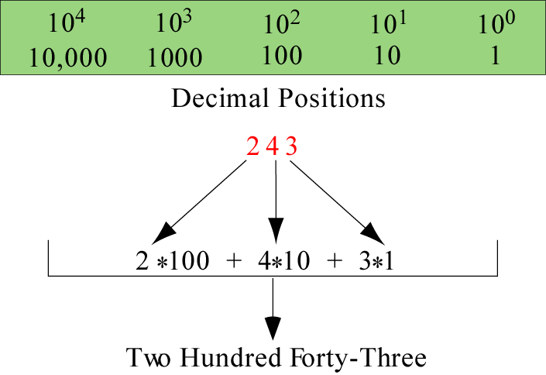
Decimal system
The decimal system has 10 digits and is based on powers of 10
(0~9)

Slide 32
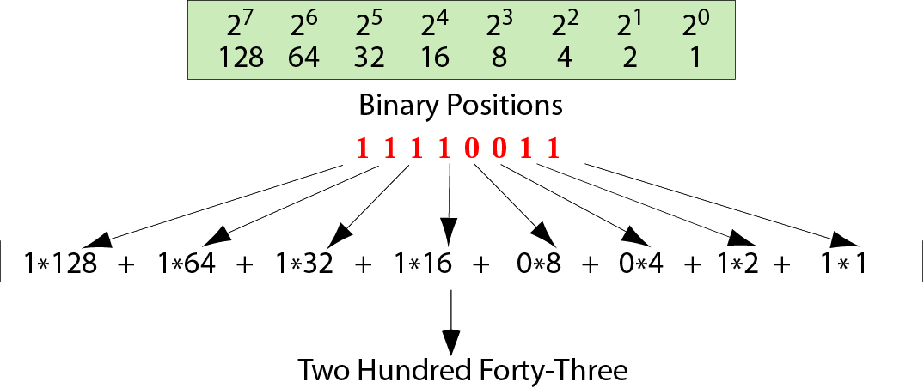
Binary system
The binary system, used by computers to store numbers, has 2 digits, 0 and 1, and is based on powers of 2.

Slide 33
CONVERSION

Slide 34
Example 1
Convert the binary number 10011 to decimal.
Solution
Write out the bits and their weights. Multiply the bit by its corresponding weight and record the result. At the end, add the results to get the decimal number.
Binary 1 0 0 1 1 Weights 16 8 4 2 1
------------------------------------- 16 + 0 + 0 + 2 + 1 Decimal 19

Slide 35
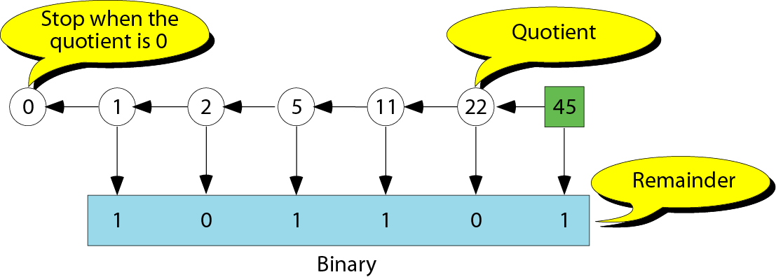
Decimal to binary conversion

Slide 36
Secondary Memory
Main memory stores instructions and data while a program is running.
Secondary memory
Stores instructions and data between sessions
A file stores data or instructions in secondary memory

Slide 37
Secondary Memory Media
A computer might have any of these types of secondary memory
Hard disk
Fast
Fixed in the computer and not normally removed
Floppy disk
Slow
Easily shared with other computers
Compact disk
Slower than hard disks
Easily shared with other computers
Can be read only or re-writable

Slide 38
Memory Access
Random Access
Usually called RAM
Computer can directly access any memory location
Sequential Access
Data is generally found by searching through other items first
More common in secondary memory

Slide 39
The Processor
Typically called the CPU
Central Processing Unit
Follows program instructions
Typical capabilities of CPU include: add subtract multiply divide move data from location to location

Slide 40
Computer Software
The operating system
Allows us to communicate with the computer
Is a program
Allocates the computer’s resources
Responds to user requests to run other programs
Common operating systems include…
UNIX Linux DOS Windows Macintosh VMS

Slide 41
Computer Input
Computer input consists of
A program
Some data
Display 1.3

Slide 42
High-level Languages
Common programming languages include … C C++ Java Pascal Visual Basic FORTRAN Perl PHP Lisp Scheme Ada C# Python
These high – level languages
Resemble human languages
Are designed to be easy to read and write
Use more complicated instructions than the CPU can follow
Must be translated to zeros and ones for the CPU to execute a program

Slide 43
Low-level Languages
An assembly language command such as ADD X Y Z might mean add the values found at x and y in memory, and store the result in location z.
Assembly language must be translated to machine language (zeros and ones) 0110 1001 1010 1011
The CPU can follow machine language

Slide 44
Compilers
Translate high-level language to machine language
Source code
The original program in a high level language
Object code
The translated version in machine language
Display 1.4

Slide 45
Linkers
Some programs we use are already compiled
Their object code is available for us to use
For example: Input and output routines
A Linker combines
The object code for the programs we write and
The object code for the pre-compiled routines into
The machine language program the CPU can run
Display 1.5

Slide 46
Chapter 1.2: Basic Concepts

Slide 47
Preliminary Three: Software Development
Computer program: Self-contained set of instructions used to operate a computer to produce a specific result
Also called software
Solution developed to solve a particular problem, written in a form that can be executed on a computer
© 2013 Cengage Learning. All Rights Reserved. This edition is intended for use outside of the U.S. only, with content that may be different from the U.S. Edition. May not be scanned, copied, duplicated, or posted to a publicly accessible website, in whole or in part.

Slide 48
Preliminary Three: Software Development (continued)
Software development procedure: Helps developers understand the problem to be solved and create an effective, appropriate software solution
Software engineering:
Concerned with creating readable, efficient, reliable, and maintainable programs and systems
Uses software development procedure to achieve this goal
© 2013 Cengage Learning. All Rights Reserved. This edition is intended for use outside of the U.S. only, with content that may be different from the U.S. Edition. May not be scanned, copied, duplicated, or posted to a publicly accessible website, in whole or in part.

Slide 49
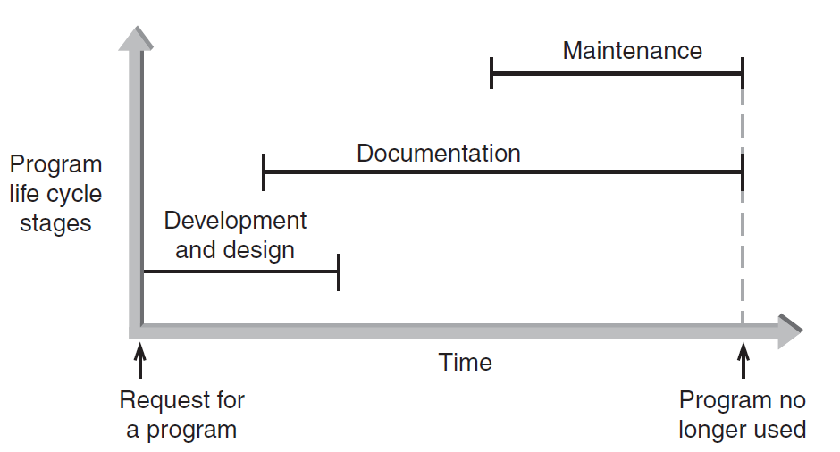
Preliminary Three: Software Development (continued)
Figure 1.2 The three phases of program development
© 2013 Cengage Learning. All Rights Reserved. This edition is intended for use outside of the U.S. only, with content that may be different from the U.S. Edition. May not be scanned, copied, duplicated, or posted to a publicly accessible website, in whole or in part.

Slide 50
Phase I: Development and Design
Program requirement: Request for a program or a statement of a problem
After a program requirement is received, Phase I begins:
Phase I consists of four steps:
Analysis
Design
Coding
Testing
© 2013 Cengage Learning. All Rights Reserved. This edition is intended for use outside of the U.S. only, with content that may be different from the U.S. Edition. May not be scanned, copied, duplicated, or posted to a publicly accessible website, in whole or in part.

Slide 51
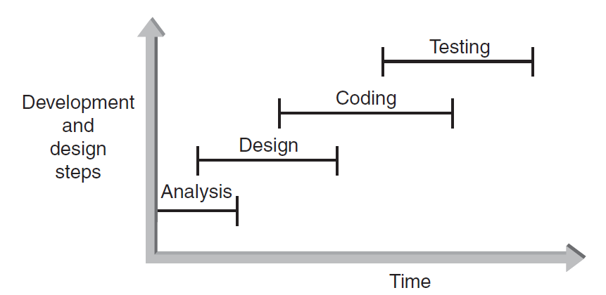
Phase I: Development and Design (continued)
Figure 1.3 The development and design steps
© 2013 Cengage Learning. All Rights Reserved. This edition is intended for use outside of the U.S. only, with content that may be different from the U.S. Edition. May not be scanned, copied, duplicated, or posted to a publicly accessible website, in whole or in part.

Slide 52
Phase I: Development and Design (continued)
Step 1: Analyze the Problem
Determine and understand the output items the program must produce
Determine the input items
Both items referred to as the problem's input/output (I/O)‏
© 2013 Cengage Learning. All Rights Reserved. This edition is intended for use outside of the U.S. only, with content that may be different from the U.S. Edition. May not be scanned, copied, duplicated, or posted to a publicly accessible website, in whole or in part.

Slide 53
Phase I: Development and Design (continued)
Step 2: Develop a Solution
Select the exact set of steps, called an “algorithm,” to solve the problem
Refine the algorithm
Start with initial solution in the analysis step until you have an acceptable and complete solution
Check solution
© 2013 Cengage Learning. All Rights Reserved. This edition is intended for use outside of the U.S. only, with content that may be different from the U.S. Edition. May not be scanned, copied, duplicated, or posted to a publicly accessible website, in whole or in part.

Slide 54
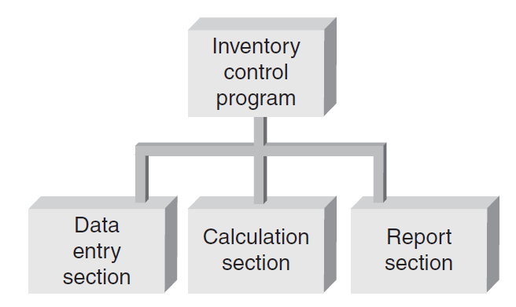
Phase I: Development and Design (continued)
Step 2: Develop a Solution (continued)
Example: a first-level structure diagram for an inventory tracking system
Figure 1.4 A first-level structure diagram
© 2013 Cengage Learning. All Rights Reserved. This edition is intended for use outside of the U.S. only, with content that may be different from the U.S. Edition. May not be scanned, copied, duplicated, or posted to a publicly accessible website, in whole or in part.

Slide 55
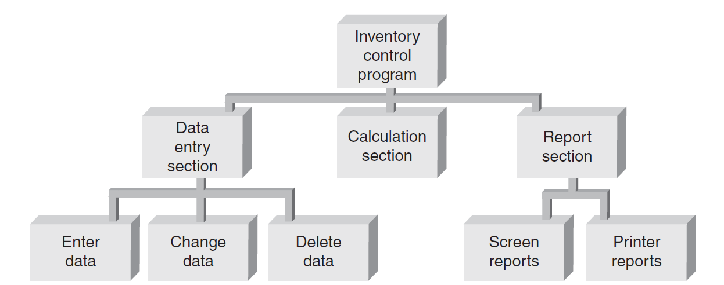
Phase I: Development and Design (continued)
Step 2: Develop a Solution (continued)
Example: a second-level structure diagram for an inventory tracking system with further refinements
Figure 1.5 A second-level structure diagram
© 2013 Cengage Learning. All Rights Reserved. This edition is intended for use outside of the U.S. only, with content that may be different from the U.S. Edition. May not be scanned, copied, duplicated, or posted to a publicly accessible website, in whole or in part.

Slide 56
Phase I: Development and Design (continued)
Step 3: Code the Solution
Consists of actually writing a C++ program that corresponds to the solution developed in Step 2
Program should contain well-defined patterns or structures of the following types:
Sequence
Selection
Iteration
Invocation
© 2013 Cengage Learning. All Rights Reserved. This edition is intended for use outside of the U.S. only, with content that may be different from the U.S. Edition. May not be scanned, copied, duplicated, or posted to a publicly accessible website, in whole or in part.

Slide 57
Phase I: Development and Design (continued)
Step 3: Code the Solution (continued)
Sequence: Defines the order in which instructions are executed
Selection: Allows a choice between different operations, based on some condition
Iteration: Allows the same operation to be repeated based on some condition
Also called looping or repetition
Invocation: Involves invoking a set of statements when needed
© 2013 Cengage Learning. All Rights Reserved. This edition is intended for use outside of the U.S. only, with content that may be different from the U.S. Edition. May not be scanned, copied, duplicated, or posted to a publicly accessible website, in whole or in part.

Slide 58
Selection
#include<iostream>
#include<cmath>
using namespace std;
int main()
{
float score;
cin>>score;
if( score>= 90)
cout<<"A";
else if(score>=80)
cout<<"B";
else if(score>=70)
cout<<"C";
else if(score>=60)
cout<<"D";
else
cout<<"F";
return 0;
}

Slide 59
Iteration
#include<iostream>
#include<cmath>
using namespace std;
int main()
{
int i;
i=1;
do
{
cout<<i<<endl;
i++;
}
while(i<=10);
return 0;
}

Slide 60
Invocation
include <iostream>
#include <cmath>
using namespace std;
double area(double r);
int main()
{
double total_area;
total_area=area(0.5)+area(2.0); // play: calculate total of a series of 10 circle with different diameters
cout<<area(0.5)<<" "<<area(2.0)<<" "<<total_area;
return 0;
}
double area(double r)
{
double pi,circle_area;
pi=4.*atan(1.);
circle_area=pi*pow(r,2);
return(circle_area);
}

Slide 61
Phase I: Development and Design (continued)
Step 4: Test and Correct the Program
Testing: Method to verify correctness and that requirements are met
Bug: A program error
Debugging: The process of locating an error, and correcting and verifying the correction
Testing may reveal errors, but does not guarantee the absence of errors
© 2013 Cengage Learning. All Rights Reserved. This edition is intended for use outside of the U.S. only, with content that may be different from the U.S. Edition. May not be scanned, copied, duplicated, or posted to a publicly accessible website, in whole or in part.

Slide 62
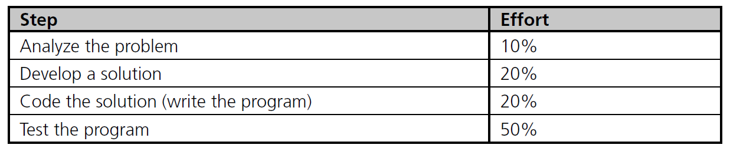
Phase I: Development and Design (continued)
Step 4: Test and Correct the Program (continued)
Table 1.3 lists the comparative amount of effort typically expended on each development and design step in large commercial programming projects
Table 1.3 Effort Expended in Phase I
© 2013 Cengage Learning. All Rights Reserved. This edition is intended for use outside of the U.S. only, with content that may be different from the U.S. Edition. May not be scanned, copied, duplicated, or posted to a publicly accessible website, in whole or in part.

Slide 63
Phase II: Documentation
Five main documents for every problem solution:
Program description
Algorithm development and changes
Well-commented program listing
Sample test runs
Users' manual
© 2013 Cengage Learning. All Rights Reserved. This edition is intended for use outside of the U.S. only, with content that may be different from the U.S. Edition. May not be scanned, copied, duplicated, or posted to a publicly accessible website, in whole or in part.

Slide 64
Phase III: Maintenance
Maintenance includes:
Ongoing correction of newly discovered bugs
Revisions to meet changing user needs
Addition of new features
Usually the longest phase
May be the primary source of revenue
Good documentation vital for effective maintenance
© 2013 Cengage Learning. All Rights Reserved. This edition is intended for use outside of the U.S. only, with content that may be different from the U.S. Edition. May not be scanned, copied, duplicated, or posted to a publicly accessible website, in whole or in part.

Slide 65
Backup
Process of making copies of program code and documentation on a regular basis
Backup copies = insurance against loss or damage
Consider using off-site storage for additional protection
© 2013 Cengage Learning. All Rights Reserved. This edition is intended for use outside of the U.S. only, with content that may be different from the U.S. Edition. May not be scanned, copied, duplicated, or posted to a publicly accessible website, in whole or in part.

Slide 66
Preliminary Four: Algorithms
Algorithm: Step-by-step sequence of instructions
Must terminate
Describes how the data is to be processed to produce the desired output
Pseudocode: English-like phrases used to describe steps in an algorithm
Formula: Mathematical equations
Flowchart: Diagrams with symbols
© 2013 Cengage Learning. All Rights Reserved. This edition is intended for use outside of the U.S. only, with content that may be different from the U.S. Edition. May not be scanned, copied, duplicated, or posted to a publicly accessible website, in whole or in part.

Slide 67
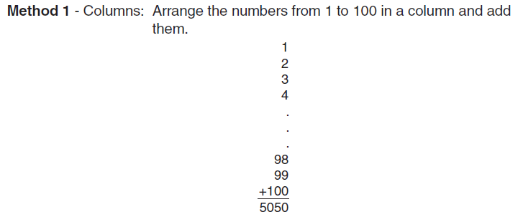
Preliminary Four: Algorithms (continued)‏
Problem: Calculate the sum of all whole numbers from 1 through 100
Figure 1.6 Summing the numbers 1 to 100
© 2013 Cengage Learning. All Rights Reserved. This edition is intended for use outside of the U.S. only, with content that may be different from the U.S. Edition. May not be scanned, copied, duplicated, or posted to a publicly accessible website, in whole or in part.

Slide 68
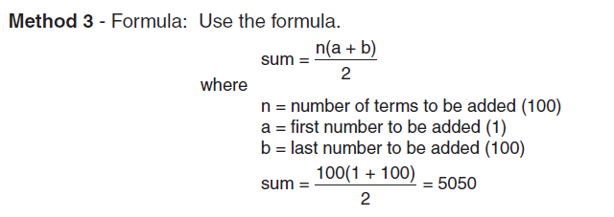
Preliminary Four: Algorithms (continued)‏
Figure 1.6 Summing the numbers 1 to 100 (continued)
© 2013 Cengage Learning. All Rights Reserved. This edition is intended for use outside of the U.S. only, with content that may be different from the U.S. Edition. May not be scanned, copied, duplicated, or posted to a publicly accessible website, in whole or in part.

Slide 69
Implementation Phase
Translate the algorithm into a programming language
Easier as you gain experience with the language
Compile the source code
Locates errors in using the programming language
Run the program on sample data
Verify correctness of results
Results may require modification of the algorithm and program
Display 1.7

Slide 70
Software, Hardware, and Computer Storage
Programming: Process of writing a program, or software
Programming language:
Set of instructions used to construct a program
Comes in a variety of forms and types
© 2013 Cengage Learning. All Rights Reserved. This edition is intended for use outside of the U.S. only, with content that may be different from the U.S. Edition. May not be scanned, copied, duplicated, or posted to a publicly accessible website, in whole or in part.

Slide 71
Machine Language
Machine language programs: only programs that can actually be used to operate a computer
Also referred to as executable programs (executables)
Consists of a sequence of instructions composed of binary numbers
Contains two parts: an instruction and an address
© 2013 Cengage Learning. All Rights Reserved. This edition is intended for use outside of the U.S. only, with content that may be different from the U.S. Edition. May not be scanned, copied, duplicated, or posted to a publicly accessible website, in whole or in part.

Slide 72
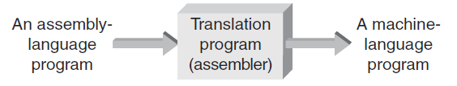
Assembly Language
Assembly language programs: Substitute word-like symbols, such as ADD, SUB, and MUL, for binary opcodes
Use decimal numbers and labels for memory addresses
Example: ADD 1, 2
Assemblers: Translate programs into machine language
Figure 1.10 Assembly-language programs must be translated
© 2013 Cengage Learning. All Rights Reserved. This edition is intended for use outside of the U.S. only, with content that may be different from the U.S. Edition. May not be scanned, copied, duplicated, or posted to a publicly accessible website, in whole or in part.

Slide 73
Low- and High-Level Languages
Low-level languages: Languages that use instructions tied directly to one type of computer
Examples: machine language, assembly language
High-level languages: Instructions resemble written languages, such as English
Can be run on a variety of computer types
Examples: Visual Basic, C, C++, Java
© 2013 Cengage Learning. All Rights Reserved. This edition is intended for use outside of the U.S. only, with content that may be different from the U.S. Edition. May not be scanned, copied, duplicated, or posted to a publicly accessible website, in whole or in part.

Slide 74
Low- and High-Level Languages (continued)‏
Source code: The programs written in a high- or low-level language
Source code must be translated to machine instructions in one of two ways:
Interpreter: Each statement is translated individually and executed immediately after translation
Compiler: All statements are translated and stored as an executable program, or object program; execution occurs later
C++ is predominantly a compiled language
© 2013 Cengage Learning. All Rights Reserved. This edition is intended for use outside of the U.S. only, with content that may be different from the U.S. Edition. May not be scanned, copied, duplicated, or posted to a publicly accessible website, in whole or in part.

Slide 75
Low- and High-Level Languages (continued)‏
Large C++ programs may be stored in two or more separate program files due to:
Use of previously written code
Use of code provided by the compiler
Modular design of the program (for reusability of components)‏
Linker: Combines all of the compiled code required for the program
© 2013 Cengage Learning. All Rights Reserved. This edition is intended for use outside of the U.S. only, with content that may be different from the U.S. Edition. May not be scanned, copied, duplicated, or posted to a publicly accessible website, in whole or in part.

Slide 76
Computer Storage
Bit: Smallest unit of data; value of 0 or 1
Byte: Grouping of 8 bits representing a single character
Character codes: Collection of patterns of 0s and 1s representing characters
Examples: ASCII, EBCDIC
© 2013 Cengage Learning. All Rights Reserved. This edition is intended for use outside of the U.S. only, with content that may be different from the U.S. Edition. May not be scanned, copied, duplicated, or posted to a publicly accessible website, in whole or in part.

Slide 77
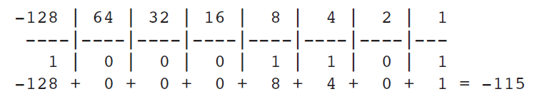
Computer Storage (continued)‏
Number codes: Patterns used to store numbers
Two’s complement number code: Represents a decimal number as a binary number of 0s and 1s
Determine with a value box
Figure 1.18 Converting 10001101 to a base 10 number
Two’s complement
© 2013 Cengage Learning. All Rights Reserved. This edition is intended for use outside of the U.S. only, with content that may be different from the U.S. Edition. May not be scanned, copied, duplicated, or posted to a publicly accessible website, in whole or in part.

Slide 78
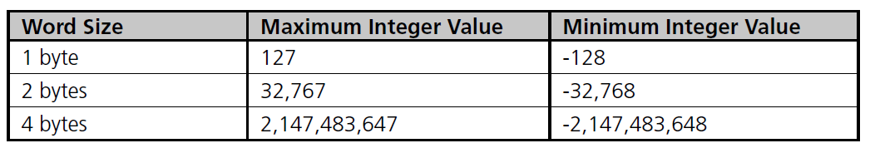
Computer Storage (continued)‏
Word: Grouping of one or more bytes
Facilitates faster and more extensive data access
Number of bytes in a word determines the maximum and minimum values that can be stored:
Table 1.4 Word size and Integer Values
© 2013 Cengage Learning. All Rights Reserved. This edition is intended for use outside of the U.S. only, with content that may be different from the U.S. Edition. May not be scanned, copied, duplicated, or posted to a publicly accessible website, in whole or in part.

Slide 79
Summary ‏
Four steps in program development and design:
Analyze the problem
Develop a solution
Code the solution
Test and correct the solution
Algorithm: Step-by-step procedure that describes how a task is performed
Computer program: Self-contained unit of instructions and data used to operate a computer to produce a desired result
© 2013 Cengage Learning. All Rights Reserved. This edition is intended for use outside of the U.S. only, with content that may be different from the U.S. Edition. May not be scanned, copied, duplicated, or posted to a publicly accessible website, in whole or in part.

Slide 80
Chapter 1 -- End

Slide 81
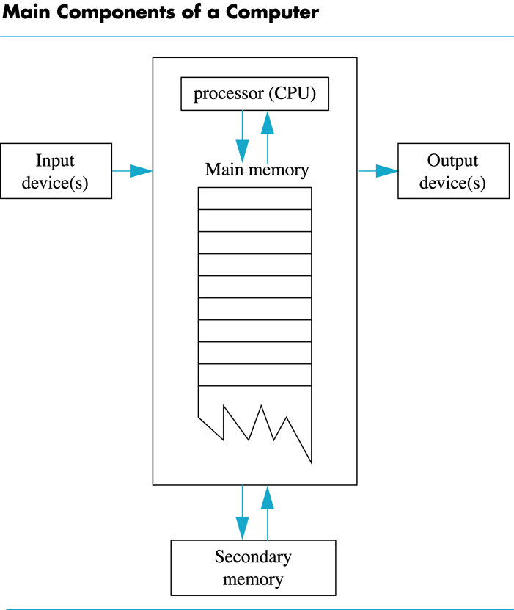
Display 1.1
Back
Next

Slide 82
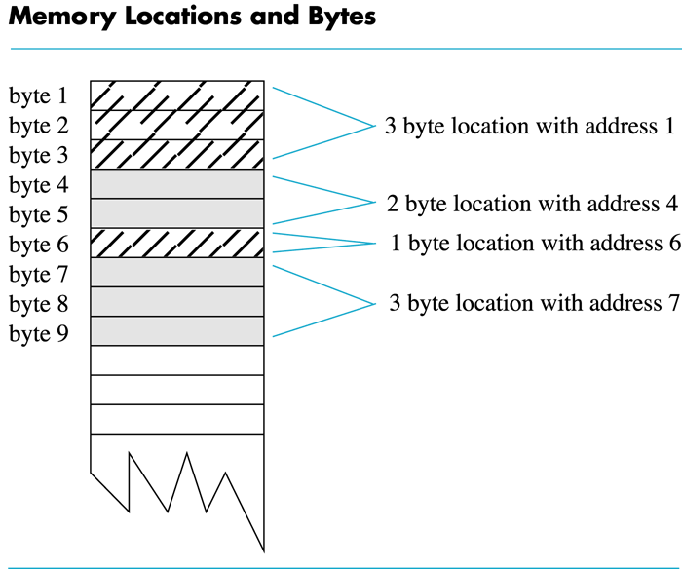
Display 1.2
Back
Next

Slide 83
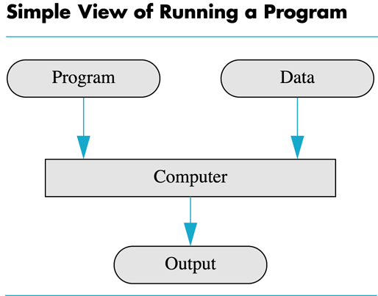
Display 1.3
Back
Next

Slide 84
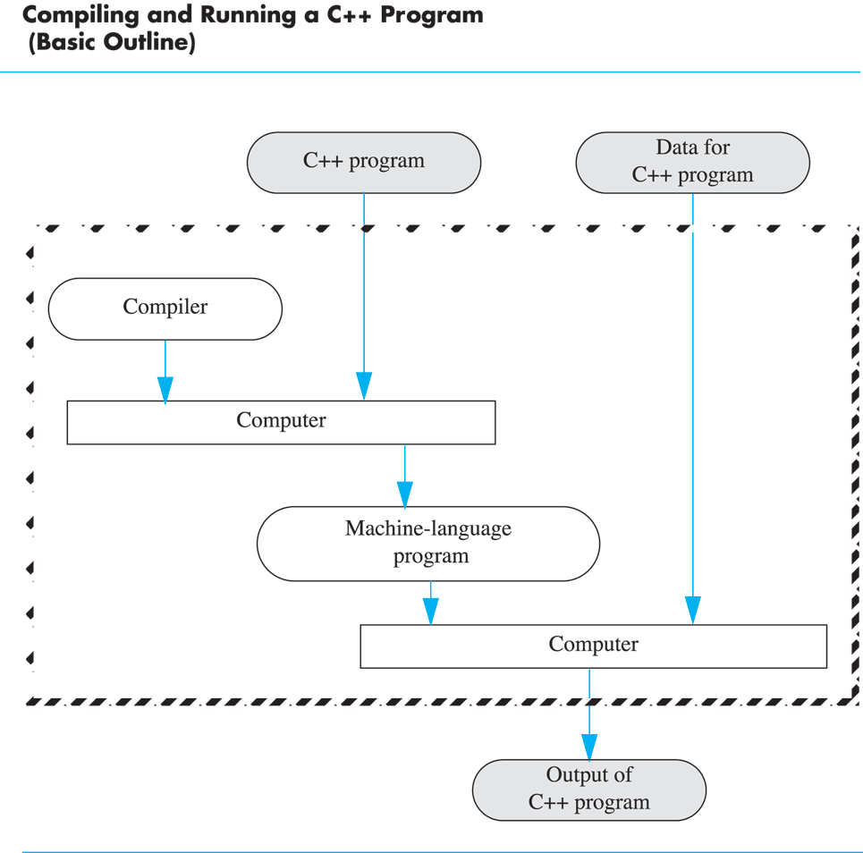
Display 1.4
Back
Next
Operate Dev-cpp one time

Slide 85
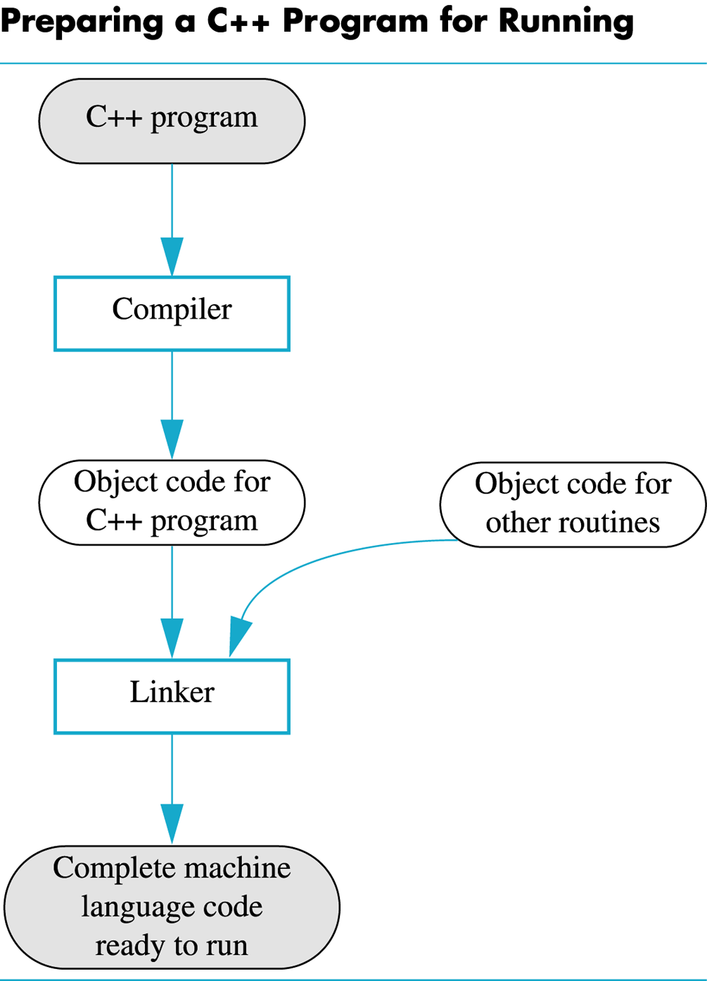
Display 1.5
Back
Next

Slide 86
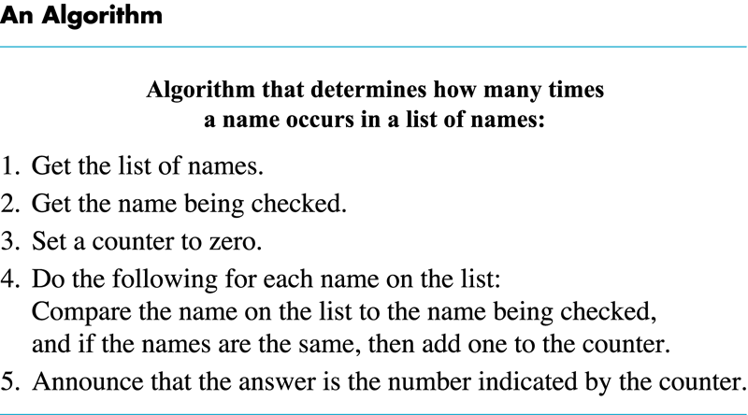
Display 1.6
Back
Next

Slide 87
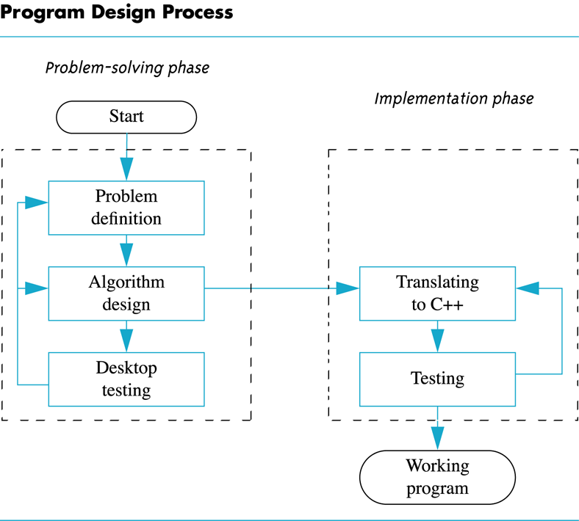
Display 1.7
Back
Next

Slide 88
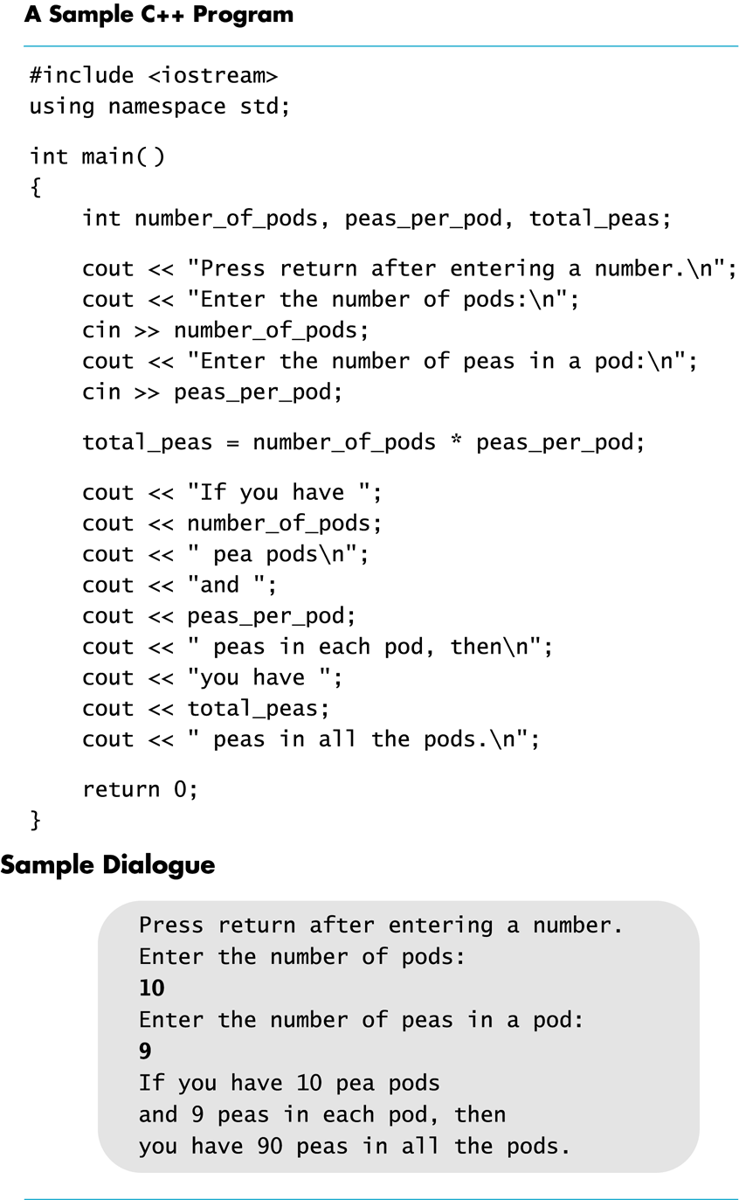
Display 1.8
Back
Next

Slide 89
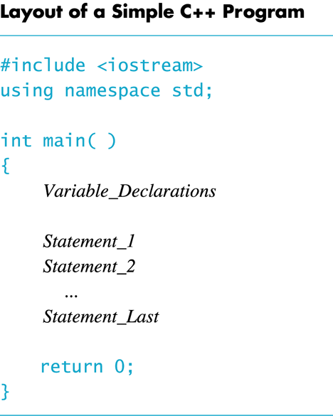
Display 1.9
Back
Next

Slide 90
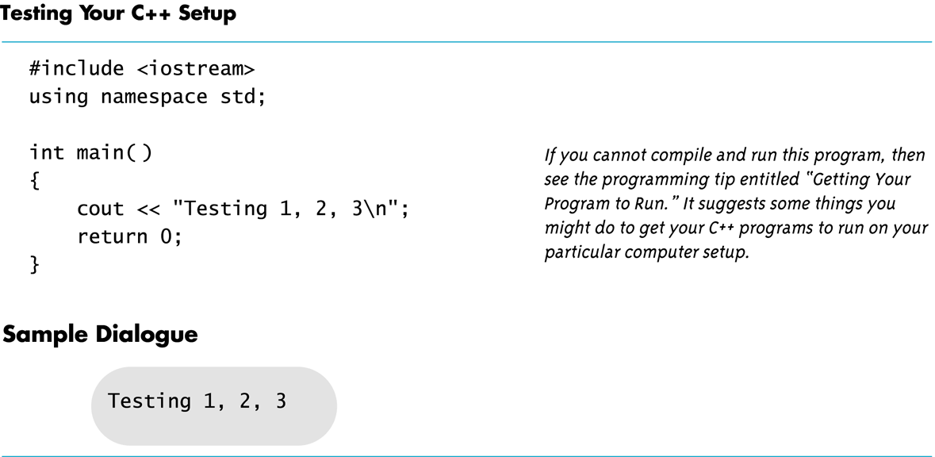
Display 1.10
Back
Next

